Slide 1

CARBON Curb
Track Tackle Thrive

Slide 2

Identifying the
Lack of Individual Action and Accountability to Reduce/Offset Carbon Emissions
Disconnection between Knowledge and Action in Individuals

Slide 3
Reasons adults reported for not taking climate action
"I think large polluters should change before individuals."
"It’s too expensive to make changes."
" I don’t think the changes I make will have any effect on climate change."
However:
Individuals contribute 40% of UK emissions.
UK government offers £7,500 grant for heat pump installation
58% of residents in major UK urban areas support increased investment in cycling infrastructure
Notes:
https://www.ons.gov.uk/economy/environmentalaccounts/articles/climatechangeinsightsuk/august2022#:~:text=make%20changes%20(30%25)-,Figure%203%3A%20Among%20those%20who%20have%20made%20no%20changes%20to%20their%20lifestyle%20to%20tackle%20climate%20change%2C%2034%25%20think%20large%20polluters%20should%20make%20changes%20before%20individuals,-Reasons%20reported%20among
https://www.theccc.org.uk/wp-content/uploads/2016/07/5CB-Infographic-FINAL-.pdf
https://www.sustrans.org.uk/our-blog/news/people-living-in-uk-cities-and-towns-want-measures-to-reduce-car-use-and-increase-cycling

Slide 4
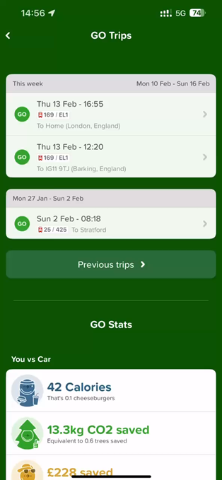
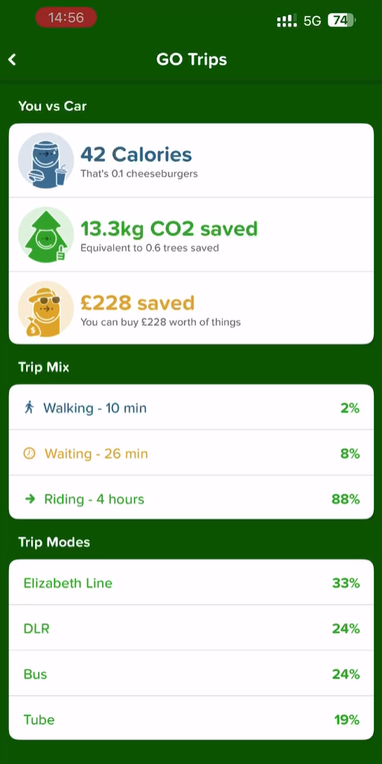
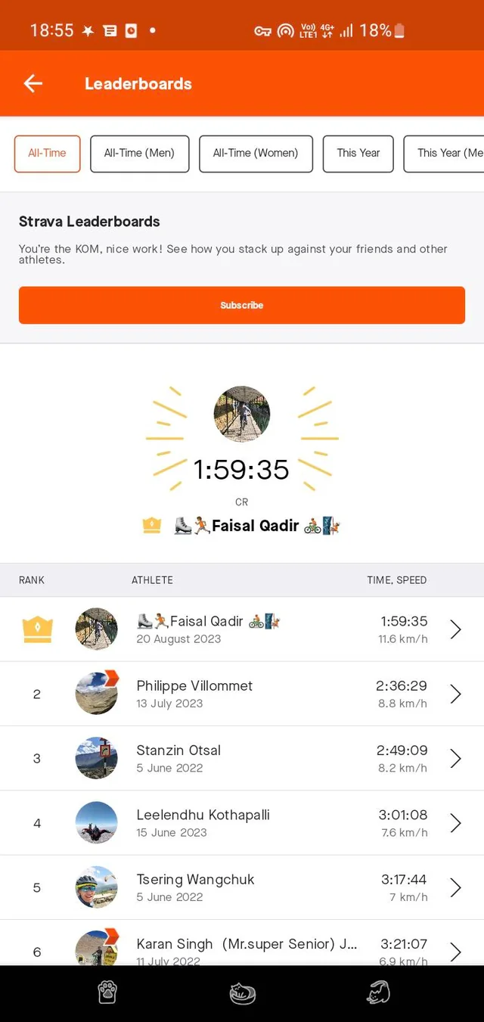
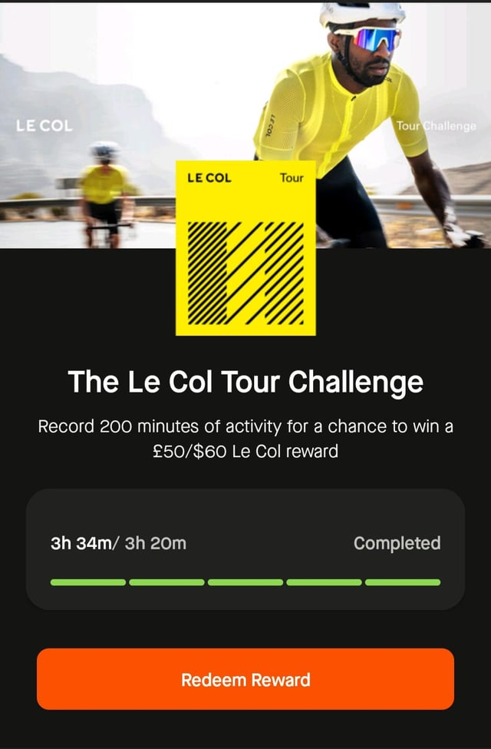
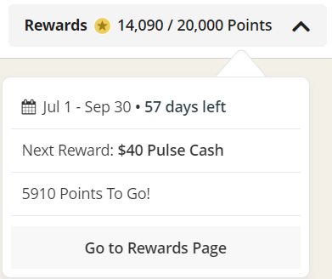
Inspirations – Apps , External Ecosystems and Gamification
Citymapper API
Travel tracking for recording carbon emissions.
Strava
User leaderboards, affiliate partners engagement campaigns and points rewards systems
Notes:
Onboarding
Partnerships B2B AND B2C

Slide 5
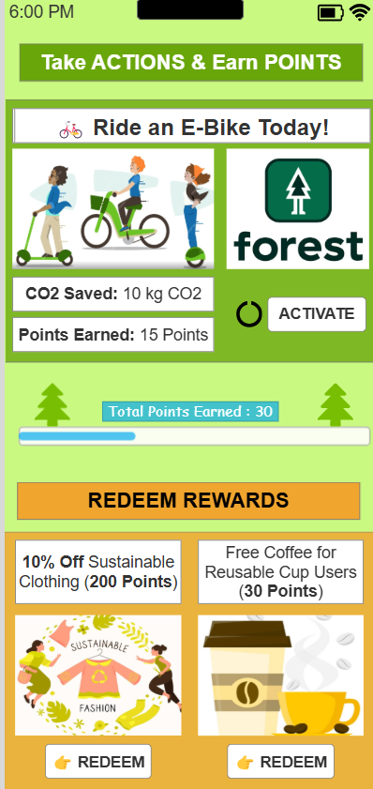
Introducing the Solution: The Carbon Curb App
Home - Tracker
Rewards (MVP) - Gamification
Feed - Engagement

Slide 6
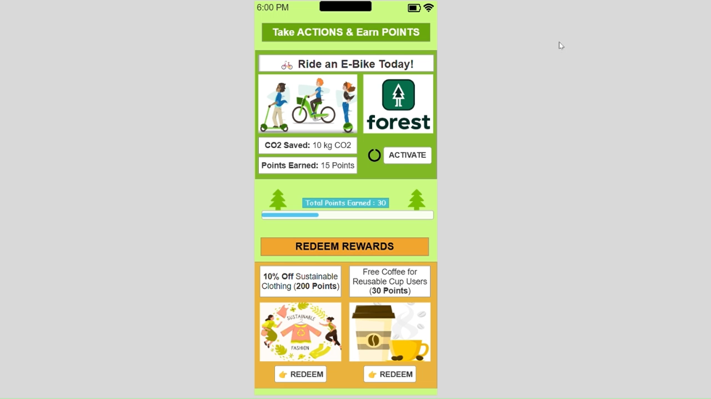

Slide 7



Roadmap of how the app integration would work…
Stage 2
Tracking of carbon emissions produced
- Selected suggestions
- AI calculated activities Reducing/offsetting
- Redeemable points at local/
small businesses
Feed
- Posts, comments, & likes
- Advertisements
- Institutions
Future/Potential
- Merchandise
- Subscription model to
remove advertisements
from feed
- Local events to volunteer
for eco-friendly initiatives
- Hybrid events to educate
- Tokens
MVP
Reducing/offsetting
- Default suggestions
- Points system
Feed
- Leaderboard
- Friends and regional
Stage 3
Tracking of carbon emission produced
- Integrated apps
Reducing/offsetting
- Redeemable points at
national/digital businesses
Notes:
Starting with start ups with the regional feature

Slide 8



Campaign
Strategies to onboard users
Reward systems
Personalised suggestions
Extra points for signing up
Partnerships with Institutions
Advertisements at universities
Government sponsorships/support
Influencers and social media
Brings in younger audience
Impact of social media usage on carbon footprint

Slide 9
Measuring Success
User Growth: Monthly active users, retention rates.
Behavioral Change: % of users adopting sustainable habits.
CO2 Reduction: Measured carbon savings from individual actions.
Token Utilization: How many tokens are redeemed, donated, or used for offsetting.

Slide 10

Legal Procedures and Regulations
1. Data Sharing Agreement (DSA)
Ownership: Clarify data ownership and user control for specific anonymized data.
Security: Require encryption and access controls.
Compliance: Ensure adherence to UK GDPR and Data Protection Act 2018.
2. Data Processing Agreement (DPA)
Retention: Specify data retention and deletion policies.
Security: Outline data protection measures.
3. Terms of Service (ToS)
Usage Rules: Define app usage rules.
Liability: Limit liability for data misuse by third parties.
4. Privacy Policy

Slide 11
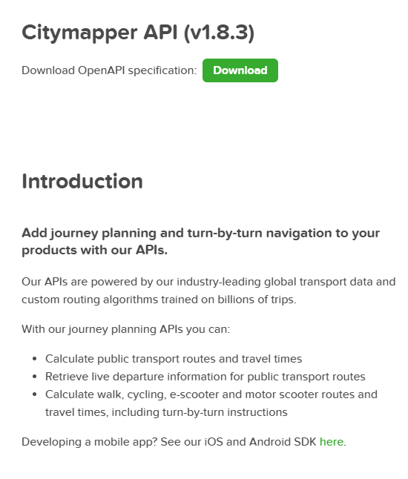
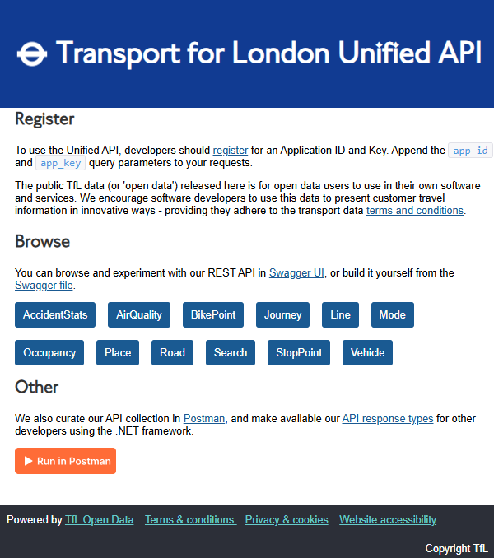
Look Back: Future Integrations and Monetisation
Subscriptions & Tokenisation
Charge businesses a small commission (1-3%) when users redeem points
Offer premium accounts for additional sustainability insights
Partners & Affiliate marketing
Governments subsidy in businesses that participate
Eco-friendly AD placement
Sustainable brands sponsor challenges, enhancing ESG and offsetting emissions
External App Integration – Travel Tracking (CityMapper & TFL API)

Slide 12
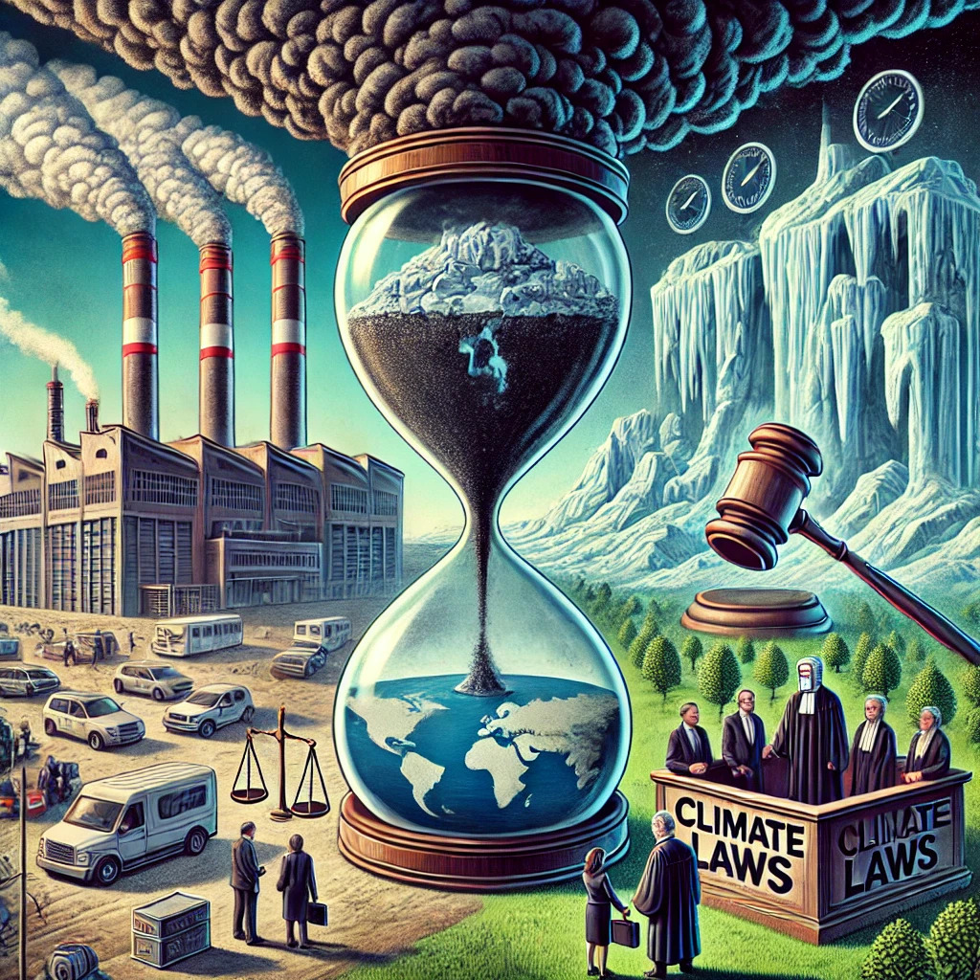

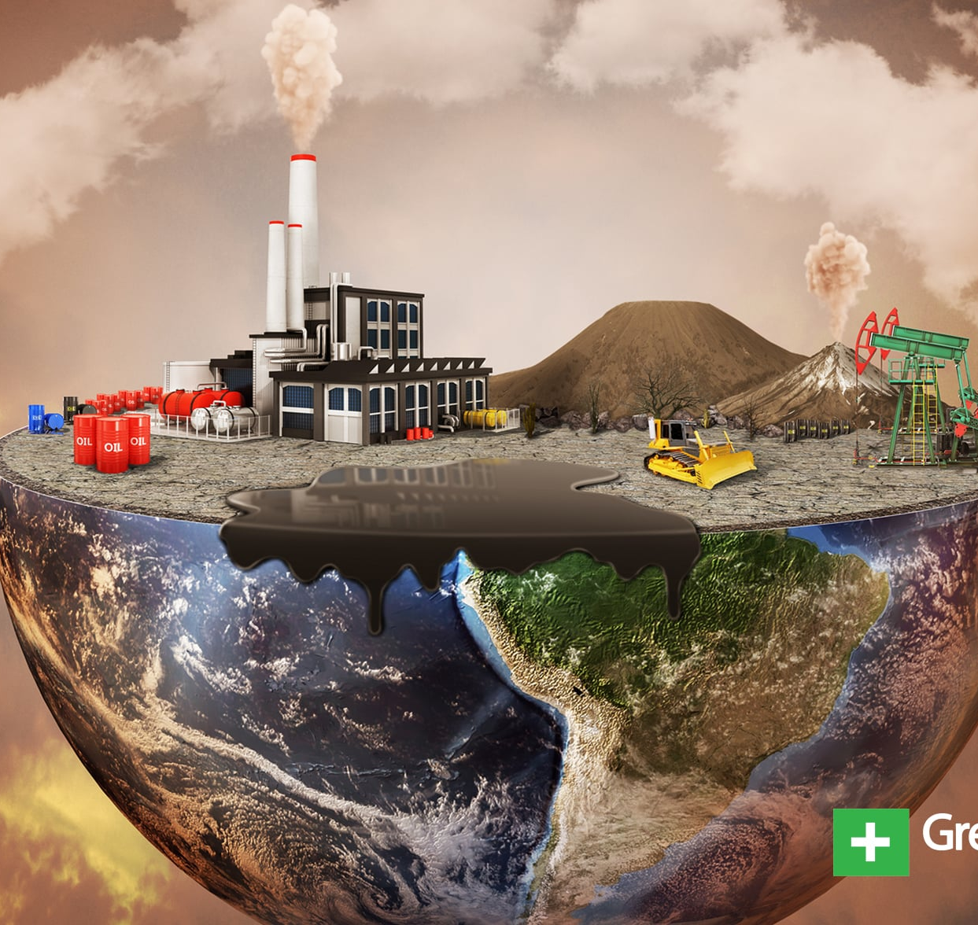
How does the problem affect you? What is the big effect?

